Slide 1

Analytic Platform with End - End Data Pipeline For Trending YouTube Video’s Statistics via Aws Services Working Backwards from “What does my Customer Needs”
The Requirement from (our simulated Customer):
Launching new Data Driven Campaign
Main Advertising Channel: YouTube
Initial Question’s / Queries to Answer:
“How to categorise Videos, Based on their Comments, Views, Subscription, Likes, Dislikes, Downloads, Ratings, Tags, Publish Time & Many More Factors that we’ll discuss in Dataset Overview Section
“What are the factors that affect how popular a YouTube video will be” ~ So that we can classify in For Ex: Top 10/20 Most Recent Trending Videos, Most Replayed Video of All Time, Most Downloaded video w.r.t Different Categories, Average/ Max / Min Watch Time Hours per Day/Month/ Year w.r.t Different Genders for each Countries.

Slide 2
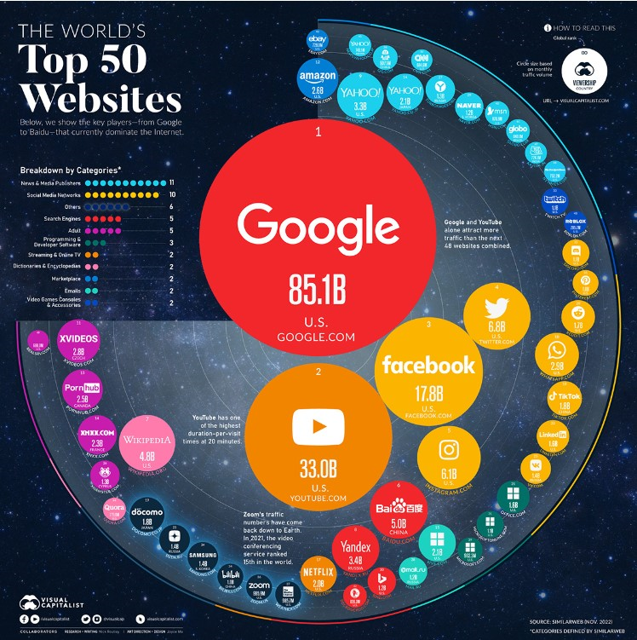
Why YouTube ?
Top three most-visited Websites (
Monthly)
Google: 92.5 Billion
YouTube: 34.6 Billion
Facebook: 25.5 Billion

Slide 3

Goals & Success Criteria
Data Ingestion
Ingest data, one-offs and
Incrementally
Data Lake
Design & Build a new Data Lake
Architecture
Aws Cloud
Aws as the Cloud Provider
ETL Design
Extract, Transform & Load data efficiently
Scalability
The Data Architecture should scale efficiently (Scale Down/ Up based on the Situation
Reporting
Build a Business Intelligence Tier,
including Dashboards, Stories.

Slide 4
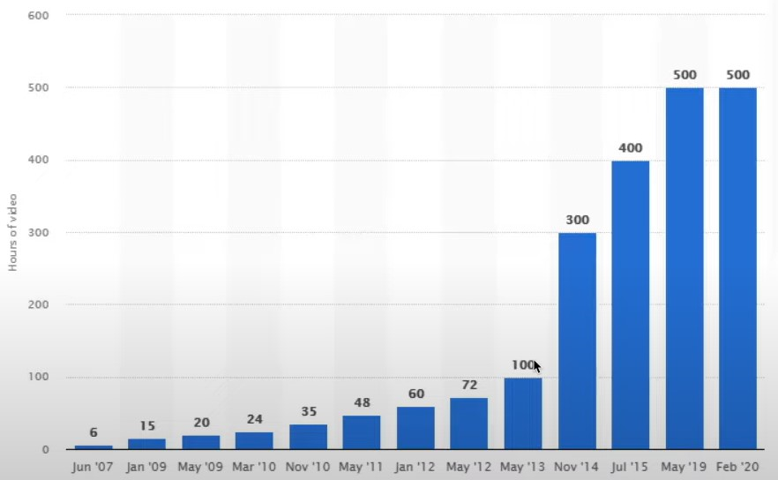
What is Big Data !!
Big Data is defined as Follows:
Massive Data Sets & Large Volume of data(Both Structured & Semi, Unstructured Data) with Varied & Complex Structure
With the Difficulties of storing & analysing Visualizing for Further Processes or Results
Applications:
Healthcare, Retail, Finance, Manufacturing & Auto- mobile Companies
Benefits: Cost Reductions, High Performance with Tight Security, Time Reductions, Smarter Business Decisions
Challenges: Bottleneck is the Workforce w.r.t required Technical Skills

Slide 5
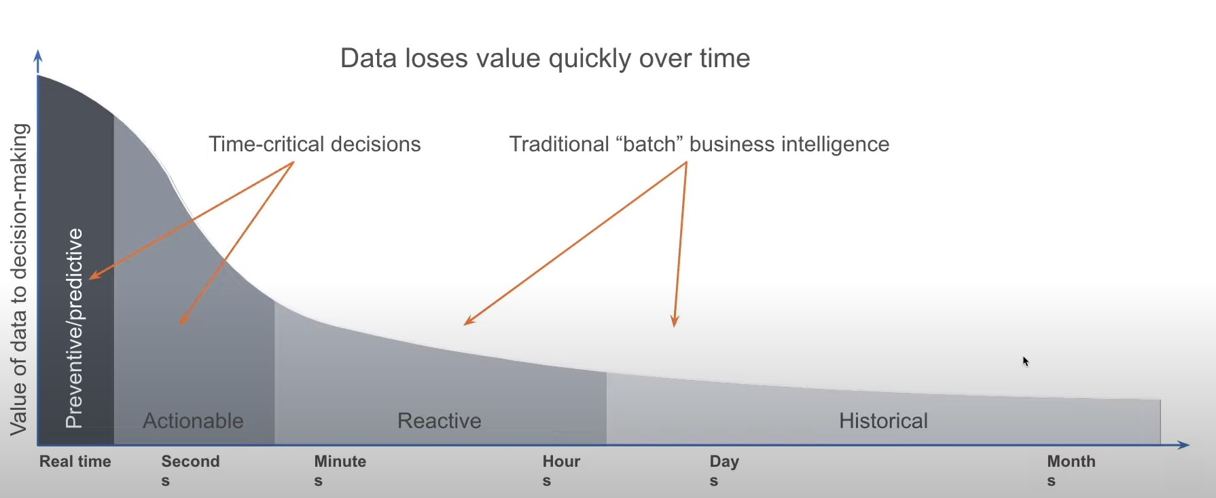
Timely Decisions & Processing Real Time Data

Slide 6
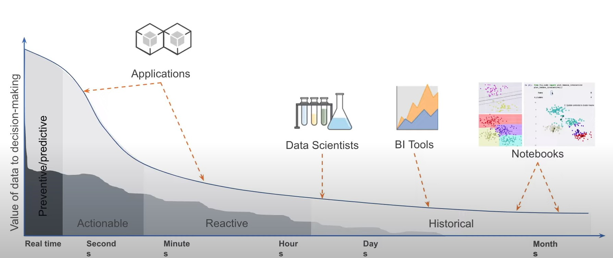
Challenges Faced while Working with Data
1. Do you think that a single Production DB can handle all these Users?
2. Data Generated v/s Data Available for Analysis.

Slide 7

What is On- Premise Data Centre
You / your company has its own hardware & Resources.
You will need to maintain all things:
Such as: Purchase, fix and upgrade the hardware
Install & Maintain OS, Authentication & Security, and other software's.

Slide 8
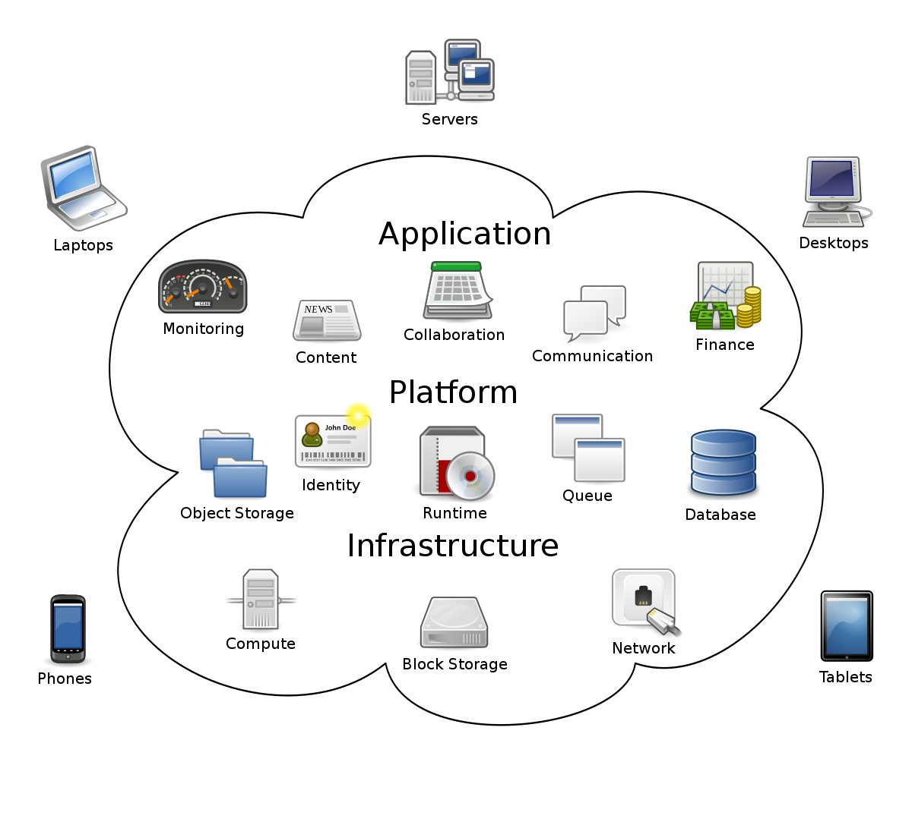
Why the Cloud is Growing So Faster
A 10 node cluster running for 10 Hours costs the same, as a 100 node cluster running for 1 Hour.
On – Premise requires extra Hardware to run the clusters means:
If needed to increase Ram, Performance & other things.
Procurement, Approval, Licensing
Shipping, Installation, Electricity(24x7), cooling systems
Underutilized & Overutilized Resources
Pay even when no one is using the Hardware
Sustainability Issues
Stats:
81% of enterprises have at least one Application in the Cloud
13% of +1k employees enterprises have migrated their entire IT environment to Cloud

Slide 9
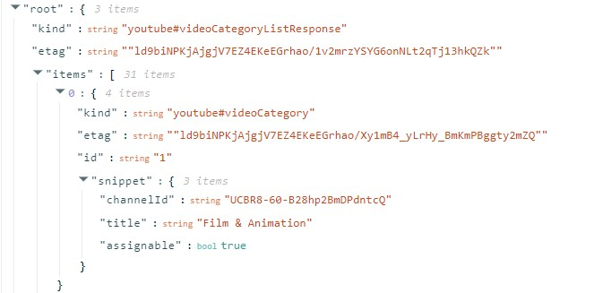
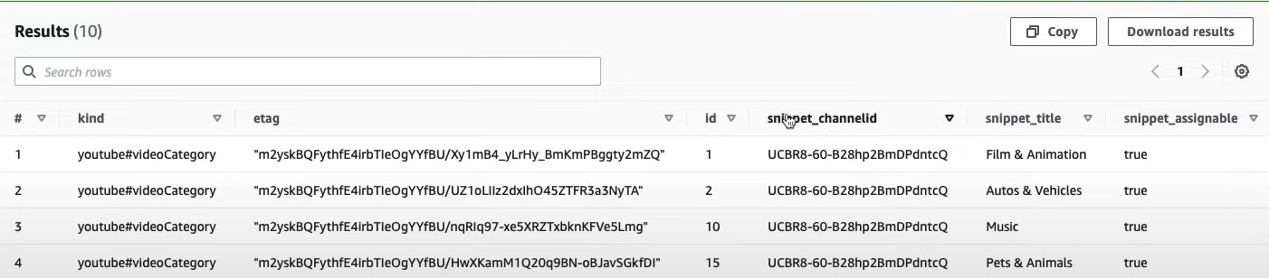
Dataset Overview: Trending YouTube Video Statistics
Here we have 2 Type’s of Files:
1.) Json Files – For each Country labelled as Country_Code_Category_id.Json is given where the videos are categories into different Categories like: Film & Animations, Sports, Science & Technology, Entertainment, Music & Many More etc. For the First Key Root → we have 3 Items, out of which Items nested Key is Required
Under the Items Key we have 30 Different Channel Ids in the List, For each Channel Id we have - 4 more nested Keys that are required, and here we’ll convert it to Parquet Format(Columnar Format – Rows & Columns), Here id is a Primary Key & since snippet act as a Struct Column so we will format it as Snippet_ChannelId, Snippet_title and Snippet_assignable.

Slide 10
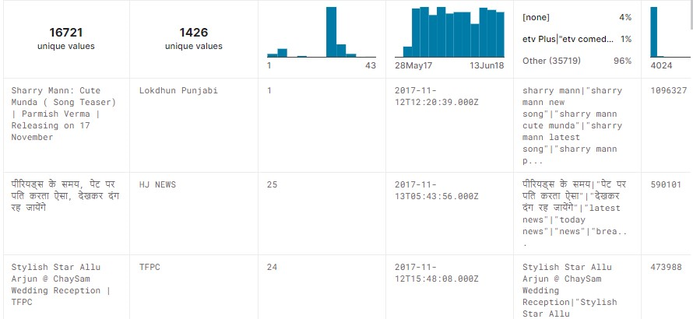
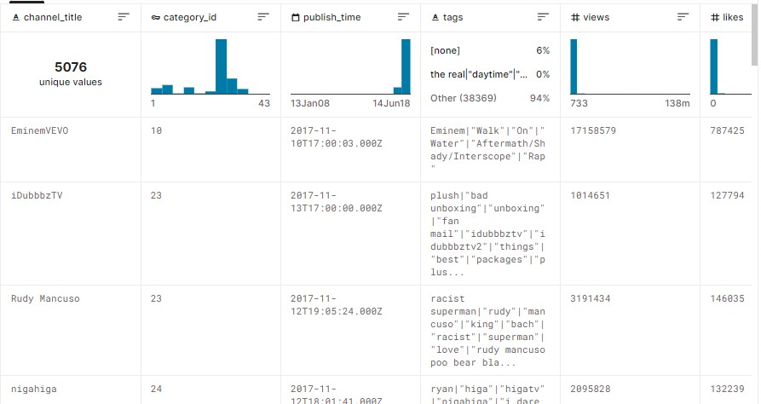
2.) Csv Files: For each Country files defined as Country_code.csv we have 16 Columns as Defined Below:
Csv File: For Different Videos w.r.t its Categories, different stats such as Views, Likes, Comments, Dislikes, Shared, Tags, Video Title & Columns as Channel_Name, Category_Id acts as a Foreign Key are given.

Slide 11
Project Description
Business Overview
Ecommerce analytics is the process of collecting data from all of the sources that affect a certain shop. Analysts can then utilize this information to deduce changes in customer behavior and online shopping patterns. Ecommerce analytics spans the whole customer journey, from discovery through acquisition, conversion, and eventually retention and support.
In this project, we will use an eCommerce dataset to simulate the logs of user purchases, product views, cart history, and the user’s journey on the online platform to create two analytical pipelines, Batch and Real-time. The Batch processing will involve data ingestion, Lake House architecture, processing, visualization using Amazon Kinesis, Glue, S3, and QuickSight to draw insights regarding the following:
Unique visitors per day
During a certain time, the users add products to their carts but don’t buy them
Top categories per hour or weekday (i.e. to promote discounts based on trends)
To know which brands need more marketing
The Real-time channel involves detecting Distributed denial of service (DDoS) and Bot attacks using AWS Lambda, DynamoDB, CloudWatch, and AWS SNS.
Data Pipeline
A data pipeline is a technique for transferring data from one system to another. The data may or may not be updated, and it may be handled in real-time (or streaming) rather than in batches. The data pipeline encompasses everything from harvesting or acquiring data using various methods to storing raw data, cleaning, validating, and transforming data into a query-worthy format, displaying KPIs, and managing the above process.
Tech Stack:
➔ Languages- SQL, Python3
➔ File Formats-Json, Parquet, Csv

Slide 12
➔ Services - AWS S3, AWS Glue, AWS Athena, Amazon Kinesis, Amazon SNS/SQS , AWS Lambda, Amazon CloudWatch, QuickSight, Apache Zepplin, Amazon DynamoDB, AWS Glue & Glue Studio & Glue Data Catalog, Aws CLI, SDK & Management Studio.
1. Amazon S3: Amazon S3 is an object storage service that provides manufacturing scalability, data availability, security, and performance. Users may save and retrieve any quantity of data using Amazon S3 at any time and from any location.
2. AWS Glue : A serverless data integration service makes it easy to discover, prepare, and combine data for analytics, machine learning, and application development. It runs Spark/Python code without managing Infrastructure at a nominal cost. You pay only during the run time of the job. Also, you pay storage costs for Data Catalog objects. Tables may be added to the AWS Glue Data Catalog using a crawler. The majority of AWS Glue users employ this strategy. In a single run, a crawler can crawl numerous data repositories. The crawler adds or modifies one or more tables in your Data Catalog after it's finished.
3. AWS Athena: Athena is an interactive query service for S3 in which there is no need to load data, and it stays in S3. It is serverless and supports many data formats, e.g., CSV, JSON, ORC, Parquet, AVRO.
4. Amazon Kinesis: Amazon Kinesis Data Streams is a real-time data collection and processing service from Amazon. Kinesis Data Streams apps are data-processing applications that may be created. Kinesis Data Firehose is part of the Kinesis streaming data platform, which also includes Kinesis Data Streams, Kinesis Video Streams, and Amazon Kinesis Data Analytics. When using Kinesis Data Firehose, the user does not need to develop apps or manage resources. Configure the data producers to send data to Kinesis Data Firehose, and the data will be automatically transferred to the specified destination. Kinesis Data Firehose may also be used to transform data before delivering it.
5. AWS QuickSight: Amazon QuickSight is a scalable, serverless, embeddable, machine learning-powered business intelligence (BI) service built for the cloud. It is the first BI service to offer pay-per-session pricing, where you only pay when your users access their dashboards or reports, making it cost-effective for large-scale deployments. It can connect to various sources like Redshift, S3, Dynamo, RDS, files like JSON, text, CSV, TSV, Jira, Salesforce, and on-premises oracle SQL-server.

Slide 13
6. Amazon SNS & SQS:
6.1 SNS is a distributed publish/subscribe solution used for application-to-application (A2A) and application-to-person (A2P) communication. SNS topics are used to enable communication: producers publish messages to topics, and consumers subscribe to these topics to receive messages. You can deliver messages to various types of subscribers, such as AWS SQS queues, AWS Lambda functions, and HTTP endpoints. You can also use SNS to send SMS messages, email, and push notifications to end-user devices.
6.2 SQS is a distributed, managed queueing service used for communication between applications, microservices, and distributed systems.
As with most messaging middleware, SQS consists of three major components:
Producers (components that send messages to the queue).
Queue (which stores messages).
Consumers (other components that receive messages from the queue).

Slide 14
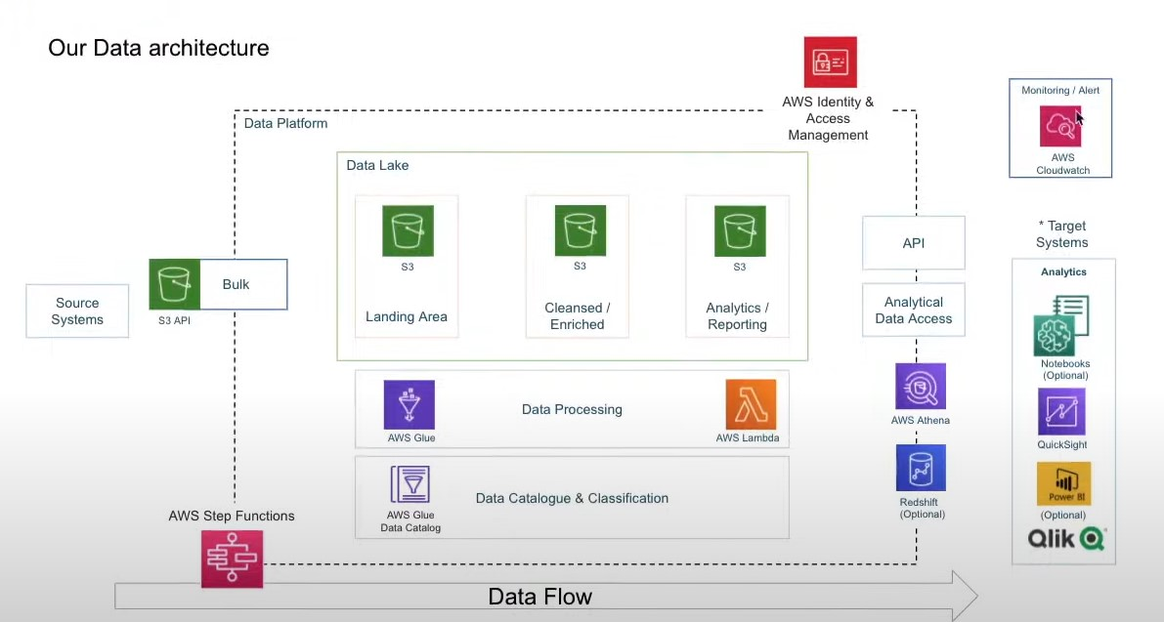

Architecture Flow Diagram
Event Notification on S3 Put
Automate Triggering of Glue ETL Job on S3 Put
Converting Json – Parquet Format
Triggering Etl Jobs On Every File Put In s3

Slide 15
Workflow: Steps involved in Building this Project
To Build Data Lake From Scratch, storing the Data in 3 Different S3’s (Raw S3, Cleaned S3, Target S3) – also creating Lambda Notification Trigger to trigger the ETL Job as soon as there is a new file added in the Raw Bucket Joining the 2 Files Json & excel on the same Column i.e. Category_id, running AWS Glue on it and adding the result to target S3 Bucket & then Visualizing the results using Aws Quicksight
Create & Sign in Aws through Console OR CLI, Login through IAM User – give it Admin Access Policy & Download the Kaggle Data On your Localhost
Before Creating a crawler which writes the metadata & creates tables via Aws Glue Catalog, Transform the Json File -> Parqueat Format via Lambda Function, and then create Aws Glue & the Crawler
Similarly without converting the file into any other format repeat the same Process with .csv Files & Query the Data Via Athena.
At the End Create an Account on Aws Quicksight & create different Dashboards according to your Clients Needs.
1.
2.
3.
4.
5.
6.
7.
Create a Raw S3 Bucket & Copy two Different Extension Files .json & .excel in 2 Different Folders
Now Query the Data with Aws Athena from the cleaned S3 Bucket being the source to Aws Glue
Know Join the 2 AWS Glue Catalog on Aws Glue Studio on Category_id Column and also create a target s3 Bucket to store the combined 2 files Query Results.

Slide 16
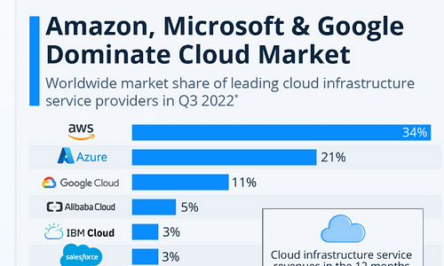
What is AWS !!
Aws Stands for Amazon Web Services, Is a cloud Provider that provides 200+ services & servers so that you can use On-Demand & Scale easily.
Some of services such as:
Virtual Machines, Compute Engines(EC2 with different OS) & Virtual Private Network
Cloud Storages & Diff Relational & Non Relational Databases, ETL Tools
IOT, Monitoring & Analytics, Containers, Deploy web & Mobile Apps
Security, Encryptions, DevOps Tools, Machine Learning, Notifications Systems

Slide 17
Create Account & Best Practises for AWS Account
Please visit the below link to create Aws Root Account & Then create any IAM User’s with the required Permissions
https://docs.aws.amazon.com/accounts/latest/reference/manage-acct-creating.html
Can Access & Create AWS Account By the Following Ways:
1. AWS Management Console: Root Name +Password + MFA
2. AWS CLI on local/ Aws Cloudshell & Aws SDK : Secret Id & Access Keys
Best Practises for Aws Accounts:
1. One Physical User = 1 Aws User
2. Assign Users to Group & Permissions to Groups
3. Create a Standard Password Policy(Follow Least Privilege Principle)
4. Don’t use your Root User Account – Use Root Account to create the IAM User, assign them some policies/permissions and use them for every day tasks
5. Use & enforce MFA
6. Use Aws Access Key for Programmatical access via CLI/SDK
7. Never share Access keys & IAM Users Names

Slide 18
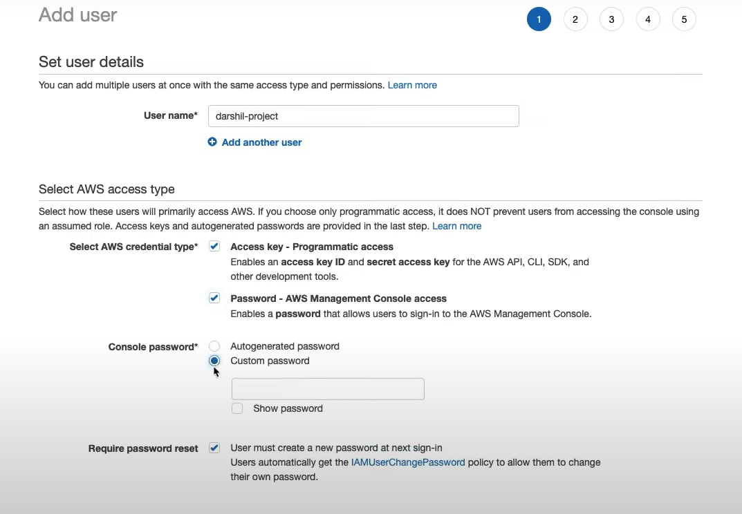
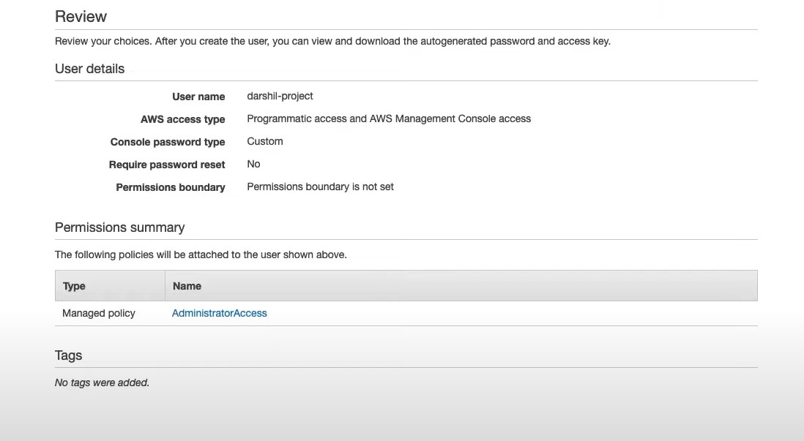
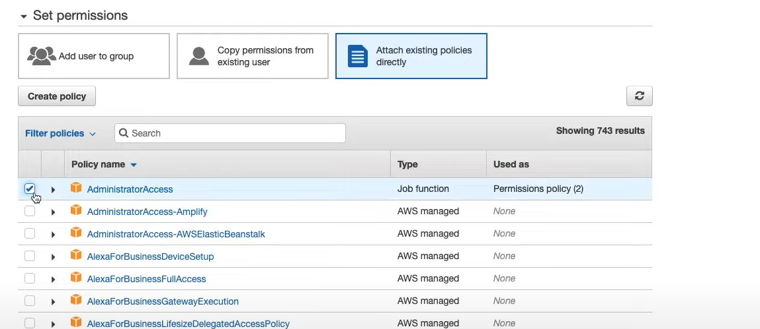
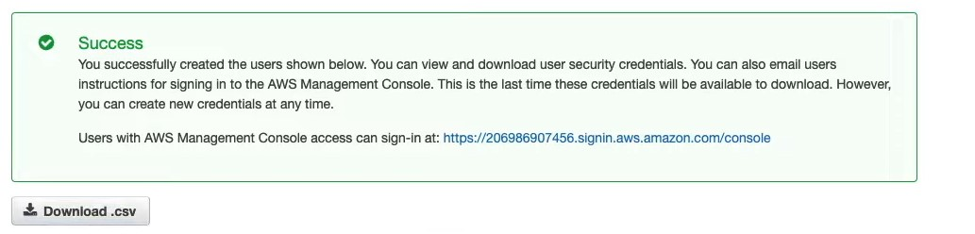
Step 1. Create an User Account & then create an IAM user assign it to a Group with the Desired Policy, but for now give the Administrator Access Policy & Download the Credential csv File on your Local.
Kunal-Project

Slide 19
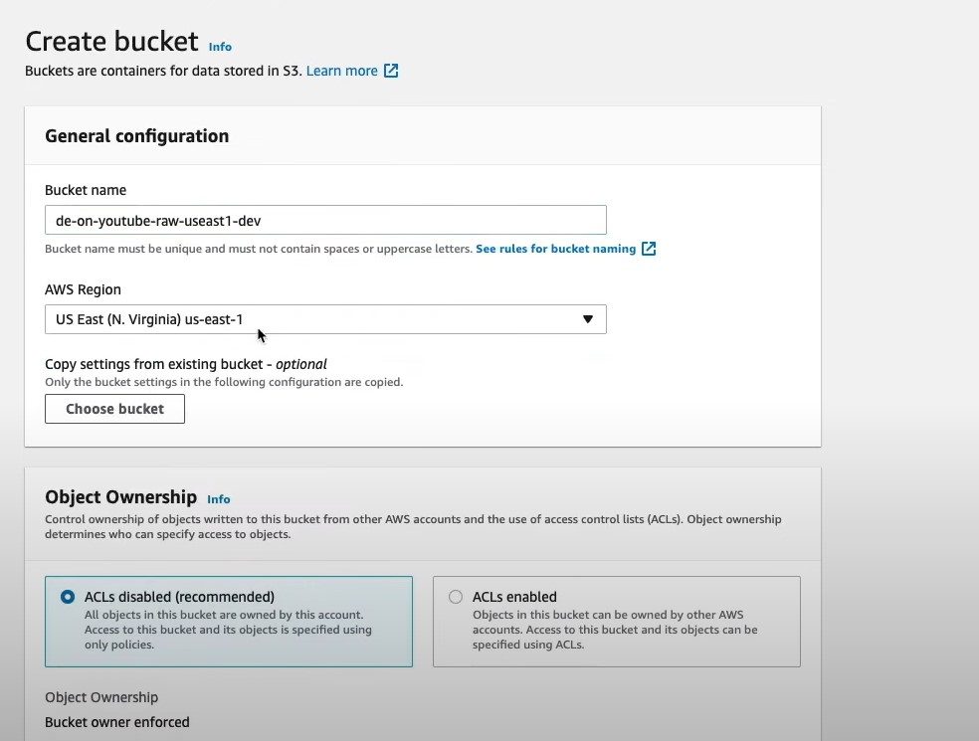
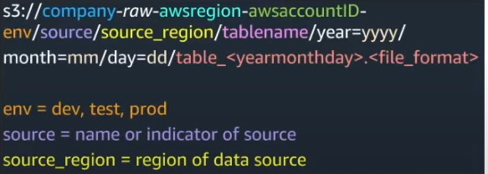
Step 2. Accessing and Log into Aws Console through CLI
Commands:
1. Aws -- version
2. Aws configure
3. Paste the Access Id & Secret Access Key
4. Then give the Region & AZ: us-east-1
Step 3. Download the data and upload in the Aws S3 Bucket named as de-on-youtube-raw-useast1-dev
Download the data from here: https://www.kaggle.com/datasets/datasnaek/youtube-new
Create an Aws S3 Object Storage Bucket, and follow the below naming convections which are defined below:
https://www.kaggle.com/datasets/datasnaek/youtube-new
Give a Unique Name w.r.t Naming Convections, the default region, For now
Block the Public Access & also you can enable Versioning if you want, &
then enable the Aws SSE – S3 Encryption.
Copy the data from your local to S3 using Aws CLI

Slide 20
Create 2 Folders:
1. Raw_statistics_reference_data Folder, that stores all the Json Files
# To copy all JSON Reference data to same location:
aws s3 cp . s3://de-on-youtube-raw-useast1-dev/youtube/raw_statistics_reference_data/ --recursive --exclude "*" --include "*.json"
2. Raw_statistics Folder , where all the csv files are stored in different folders according to their Country Code
# To copy .csv Files w.r.t there Country Code Folders:
aws s3 cp CAvideos.csv s3://de-on-youtube-raw-useast1-dev/youtube/raw_statistics/region=ca/
aws s3 cp DEvideos.csv s3://de-on-youtube-raw-useast1-dev/youtube/raw_statistics/region=de/
aws s3 cp FRvideos.csv s3://de-on-youtube-raw-useast1-dev/youtube/raw_statistics/region=fr/
aws s3 cp GBvideos.csv s3://de-on-youtube-raw-useast1-dev/youtube/raw_statistics/region=gb/
aws s3 cp INvideos.csv s3://de-on-youtube-raw-useast1-dev/youtube/raw_statistics/region=in/
aws s3 cp JPvideos.csv s3://de-on-youtube-raw-useast1-dev/youtube/raw_statistics/region=jp/
aws s3 cp KRvideos.csv s3://de-on-youtube-raw-useast1-dev/youtube/raw_statistics/region=kr/
aws s3 cp MXvideos.csv s3://de-on-youtube-raw-useast1-dev/youtube/raw_statistics/region=mx/
aws s3 cp RUvideos.csv s3://de-on-youtube-raw-useast1-dev/youtube/raw_statistics/region=ru/
aws s3 cp USvideos.csv s3://de-on-youtube-raw-useast1-dev/youtube/raw_statistics/region=us/

Slide 21
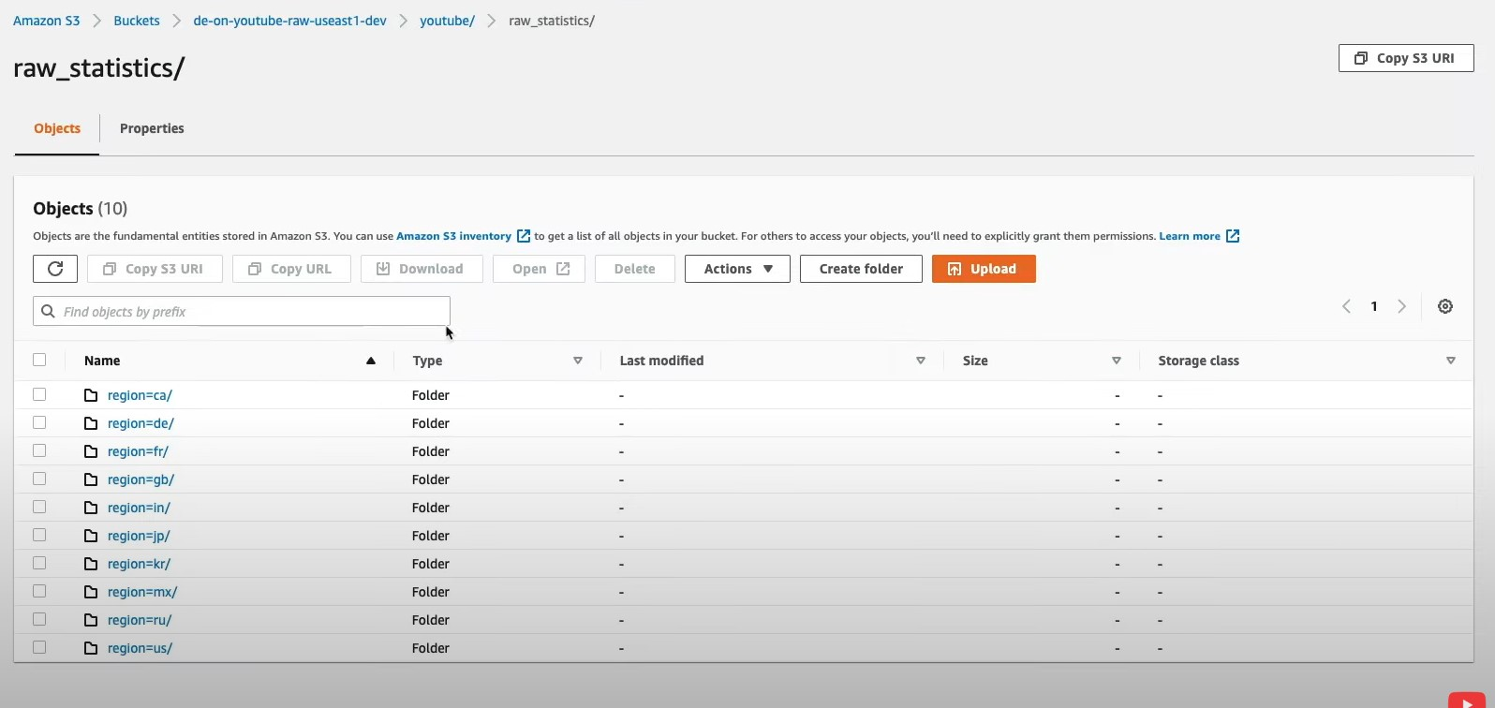
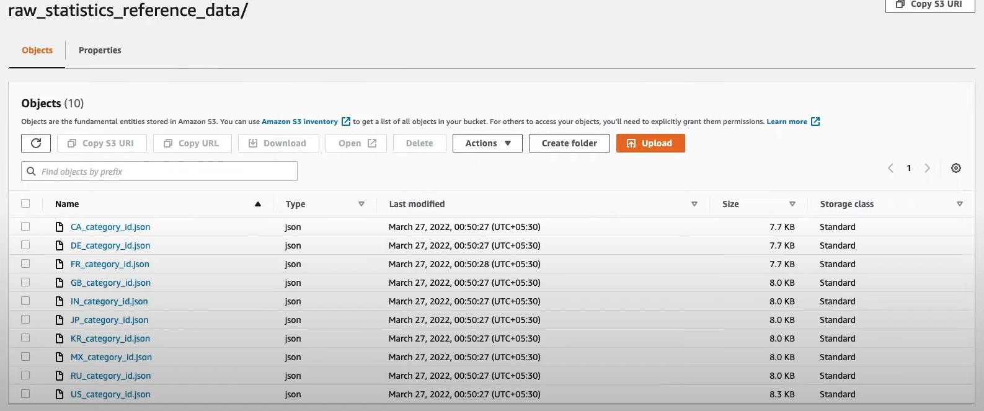
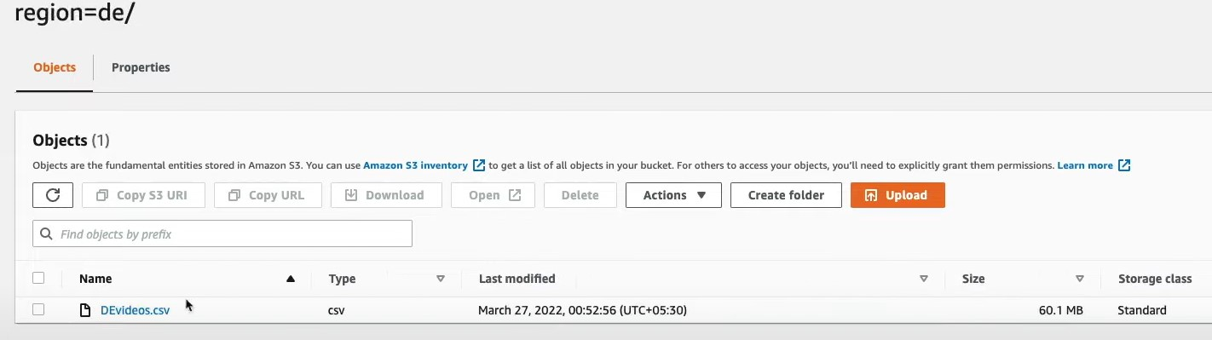
We have Two Folders – raw_statistics – For Region wise .csv Files & raw_statistics_reference_data for .Json Files

Slide 22

Agenda
Basics of Lake House Architecture
What is Aws Glue Data Catalog
Cataloging our YouTube Data

Slide 23
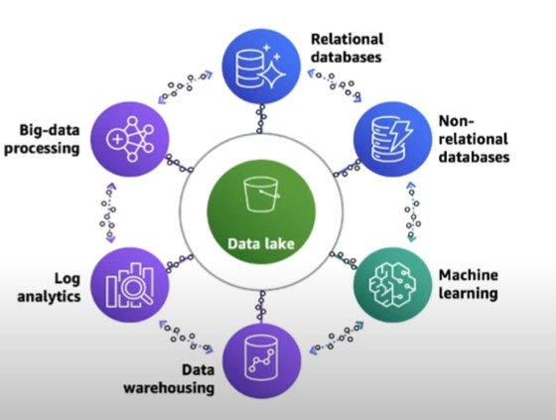
What is Data Lake House Architecture ?
A data lake Is a massive repository of structured and unstructured data, and the purpose for this data has not been define, & Use for Running ELT/ETL Jobs
Key Elements:
Scalable Data Lakes
Purpose – Built Data Services
Seamless Data Movement
Unified Governance
Performant & Cost - Effective

Slide 24

AWS Lake Formation
Data lake = central place to have all your data for analytics purposes
• Fully managed service that makes it easy to setup a data lake in days
• Discover, cleanse, transform, and ingest data into your Data Lake
• It automates many complex manual steps (collecting, cleansing, moving, cataloging data, …) and de-duplicate (using ML Transforms) • Combine structured and unstructured data in the data lake
• Out-of-the-box source blueprints: S3, RDS, Relational & NoSQL DB…
• Fine-grained Access Control for your applications (row and column-level) • Built on top of AWS Glue

Slide 25

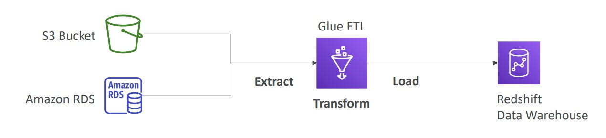
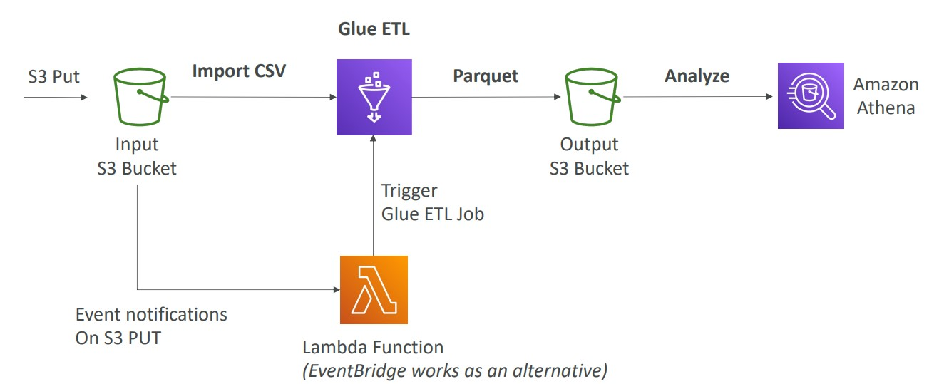
Aws Glue
1. Managed ETL Service
2. Useful to prepare & Transform Data for Analytics
3. Fully Serverless Service
Aws Glue: Convert Data Into Parquet Format

Slide 26

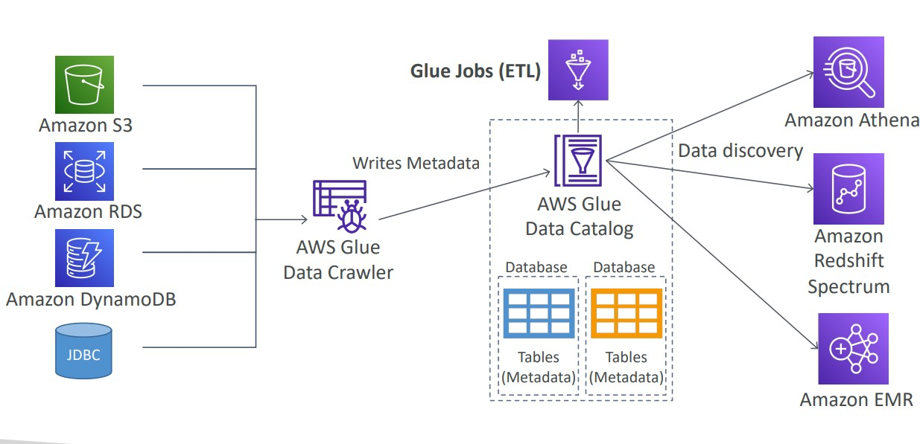
Glue Data Catalog: Catalog Of Datasets
Crawler access the data coming from different data stores – writes the meta-data & create Db & tables in Aws Glue Data Catalog & thus this is the whole process for Aws Glue

Slide 27
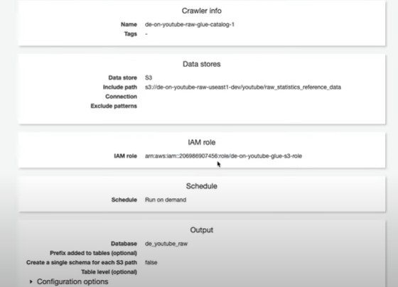
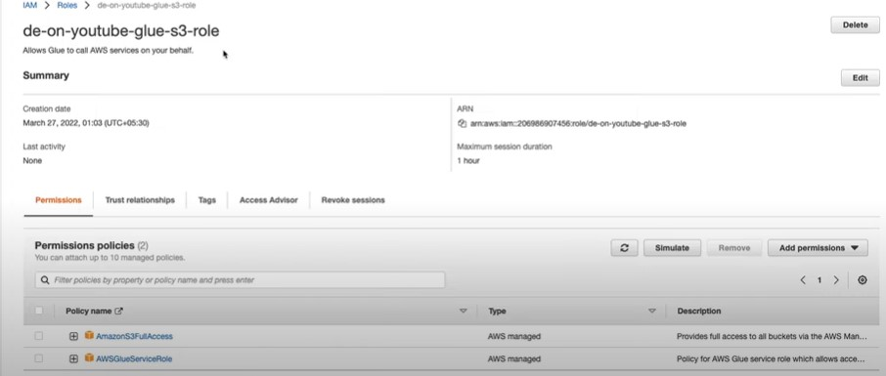
Step 3. We’ll know use Aws Glue(managed ETL service) create a Crawler & Glue Data Catalog, which takes the data from multiple sources like(s3,rds,DynamDB, JDBC(On Premises Database) – performs ETL and then can use Athena/ Redshift Spectrum to Query & Analyse, Redshift, Emr for Big Data Analysis.
3.1 Create a Crawler – give a unique name to it, choose a data store as s3 and give the path of Json files → For Glue to access S3 (service – to access service) we need to create & attach the IAM Role as defined below and give 2 permissions: 1. Aws S3 full access, 2. Aws Glue service Role → create a new Database & then click on create Crawler and run it.

Slide 28
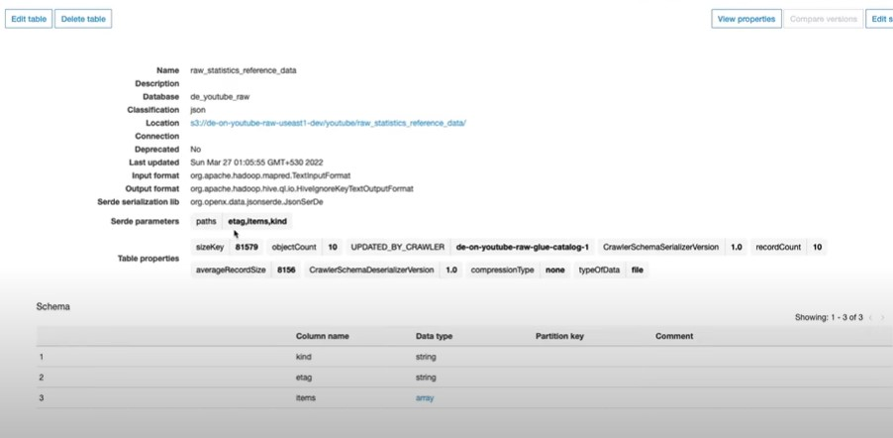
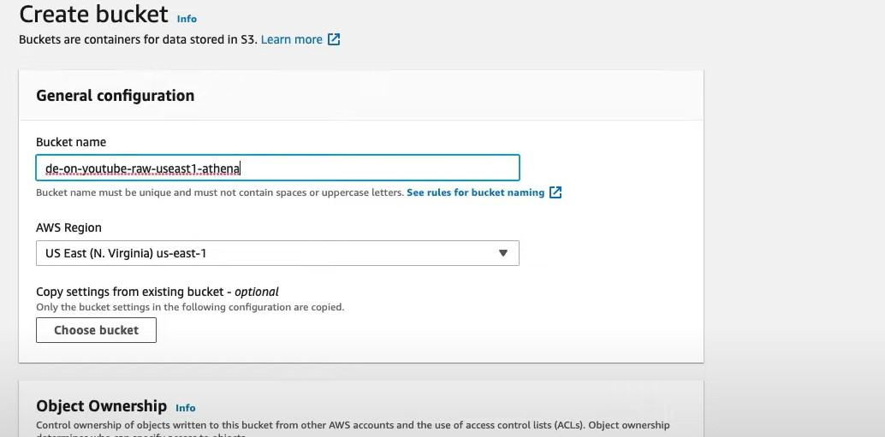
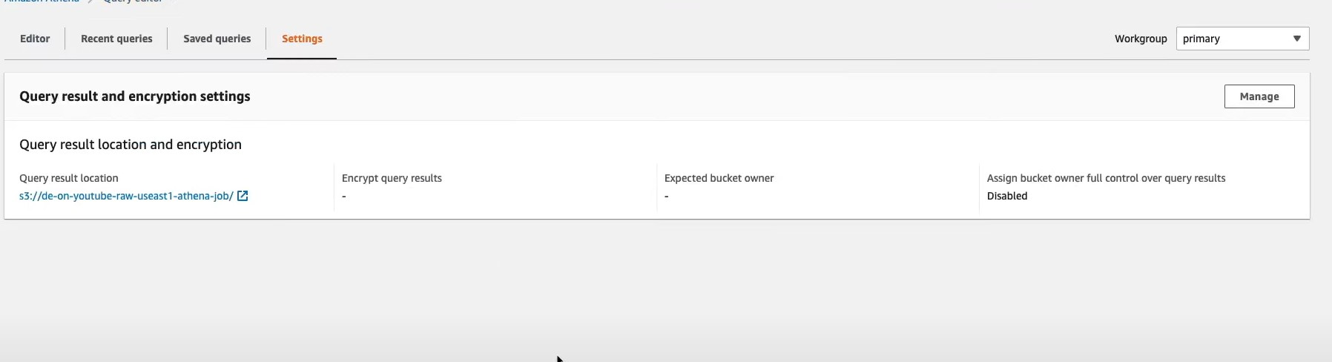
3.2 Table will be created and it has 3 columns kind, etag and items ~ Struct array
3.3 At Top Left go to view Data – actions – query data – aws athena will open.
3.4 For Athena to store the output results of the Query, we need to create a new bucket for it and then attach the bucket to Athena.

Slide 29
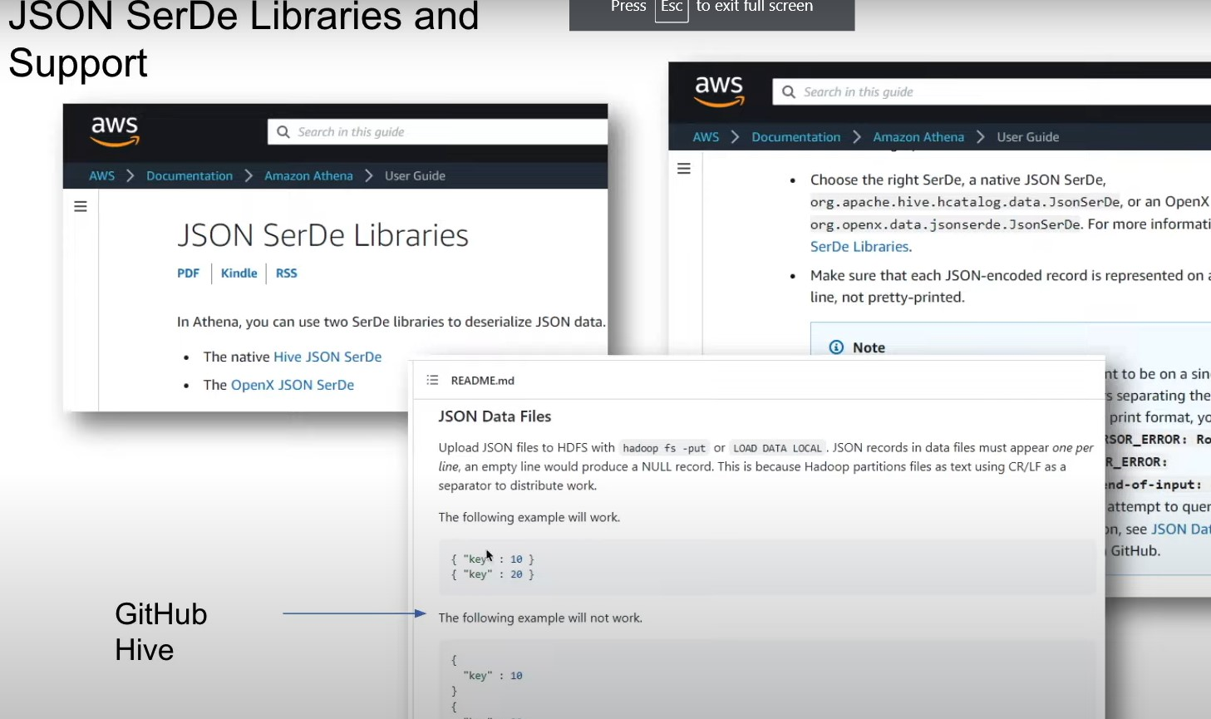
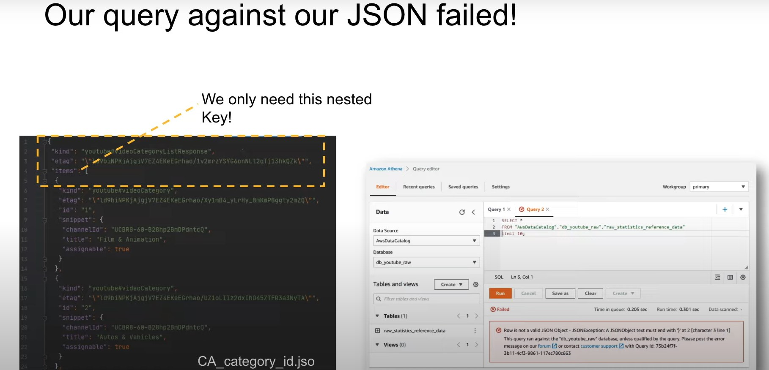
3.5 While Running the Query against the Un – Processed Json data the Query Failed – Because as shown in the picture below kind, etag are not required and for the Nested key: Value pair present are required where the key will act as Columns & the Values will be present in the rows. Hence we need to Clean & Process the data first and then Query the Data.

Slide 30
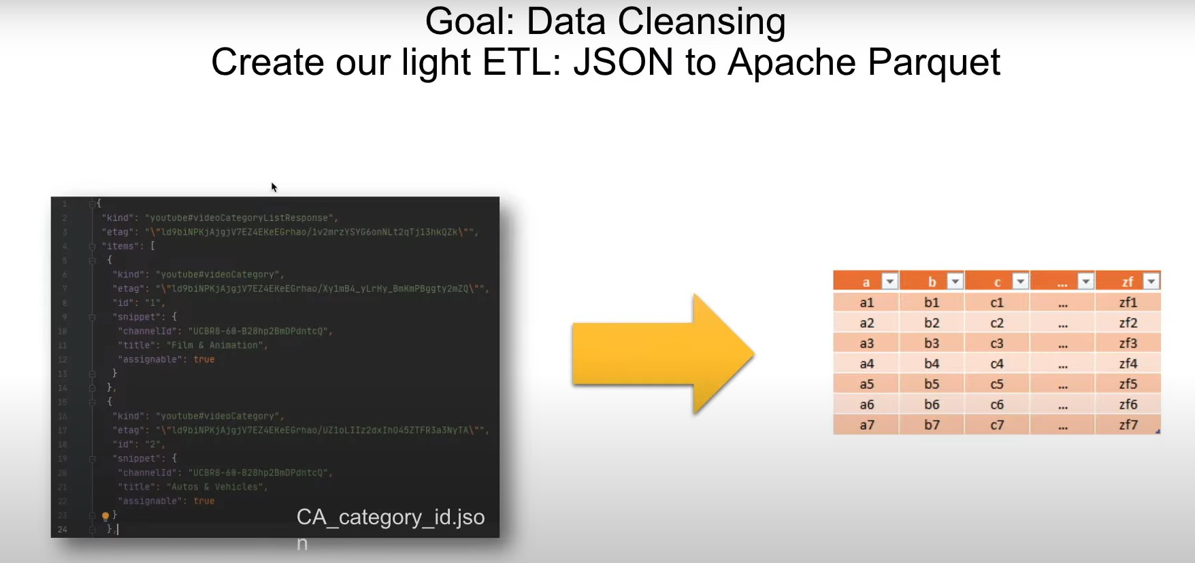

Slide 31
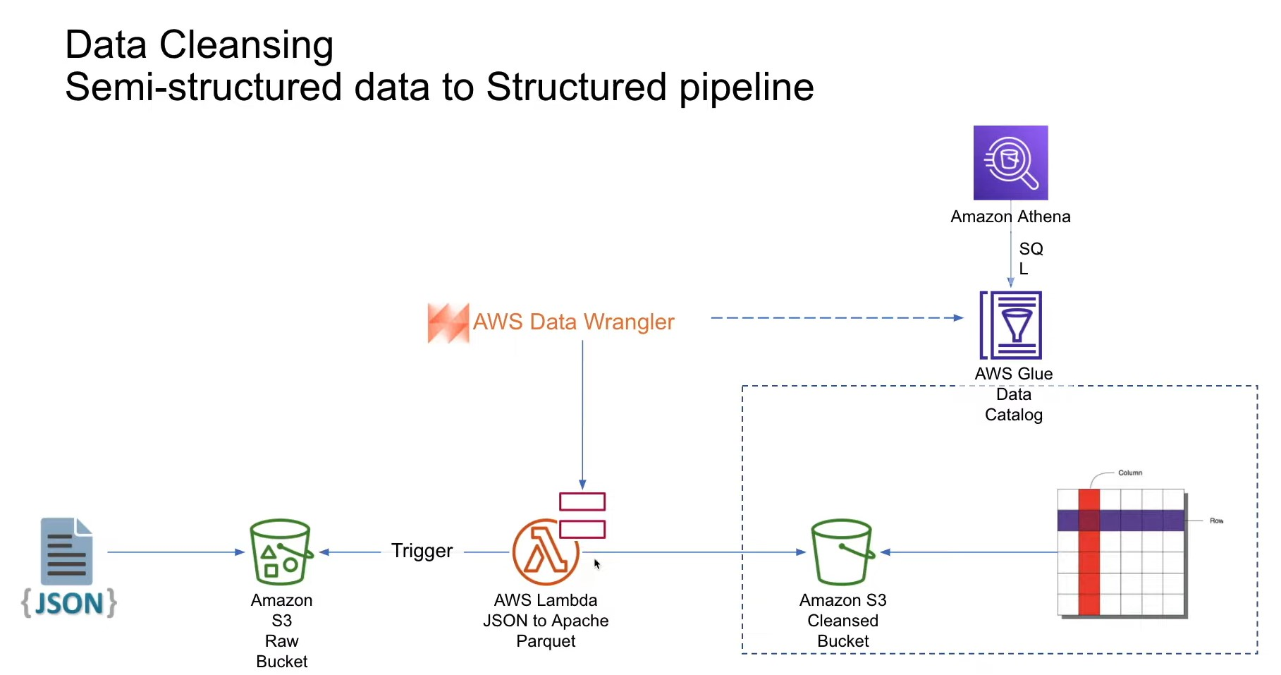

Slide 32
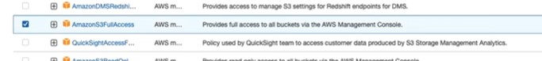
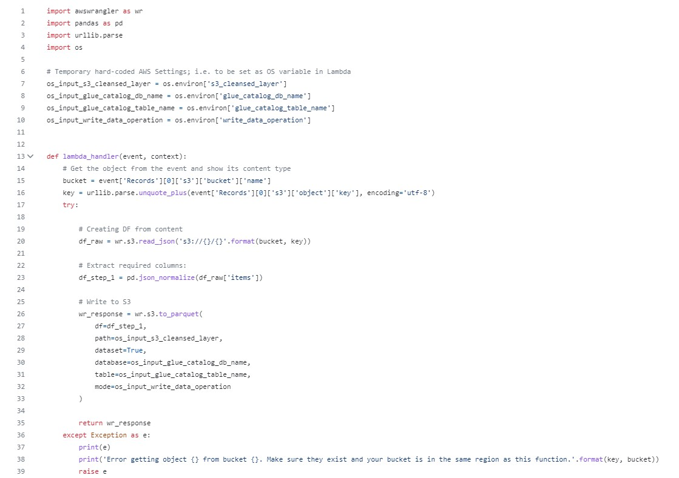
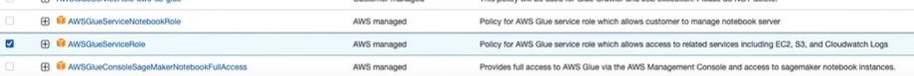
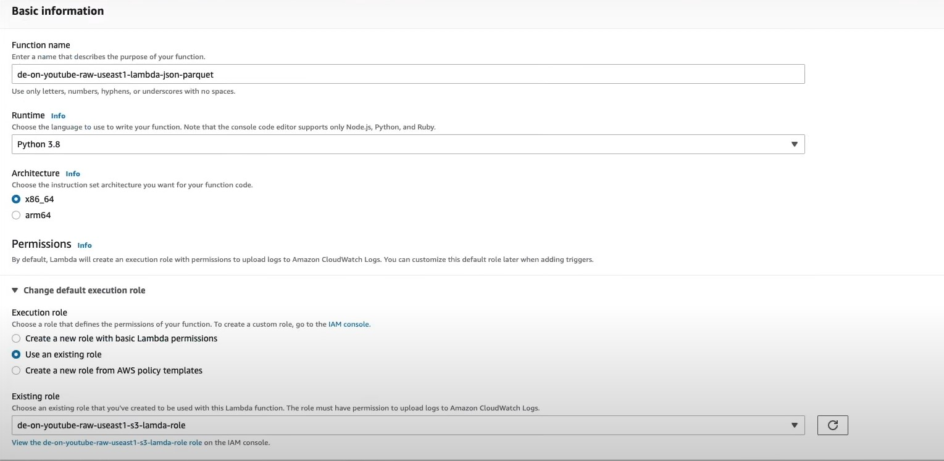
Step 4
4.1 Now as defined previously, we need to pre-process the Json Data, so as to store in Row & Column format, so for it we’ll create A Lambda Function Trigger it to convert Json data to parquet format (R/C), also create and attach the new IAM role for Lambda to access the s3 bucket & also for accessing the Aws Glue as defined below:
4.2 Go to Lambda Function and write the below code to pre-process the data and also create one more s3 bucket - clean bucket which stores the processed data in Parquet Format
Role with s3 & Glue Permissions
Code for Converting the Data in Parquet Format
Lambda Function

Slide 33
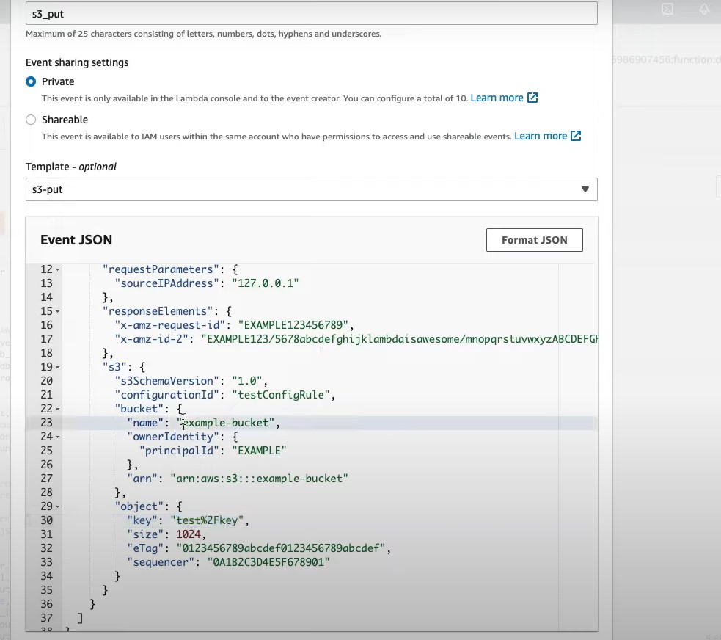
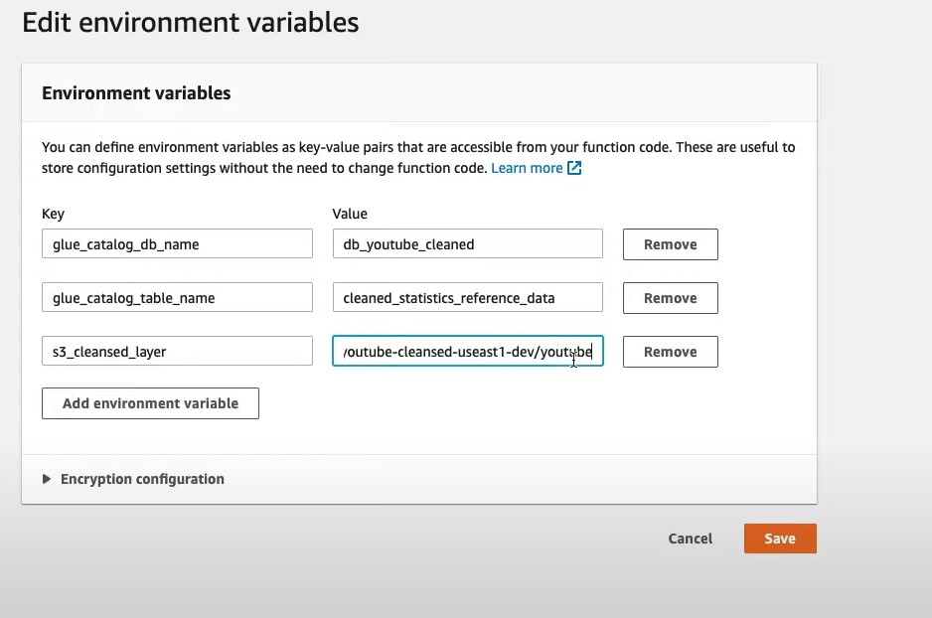
4.3 Also edit the environment variables of the Lambda Function as:
Give the Db Name, Table Name, The Bucket which will store the Cleansed Data after Lamda does it’s work
4.4 Before deploying your Lambda Function, first test it – there give the action as s3 Put and in the event Json update the raw bucket name & its key(folder Path excluding the bucket name) & then test it.
Note: Use Aws Lambda Layers to import Important Libraries like aws wrangler, pandas, os, numpy & urlib etc.
Also increase/ decrease your timeout based on the time your code takes to run.

Slide 34
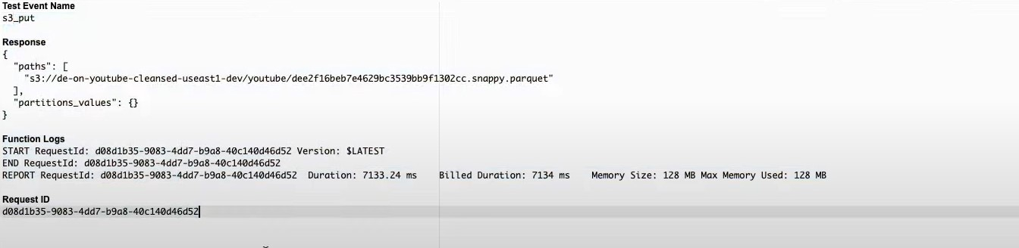
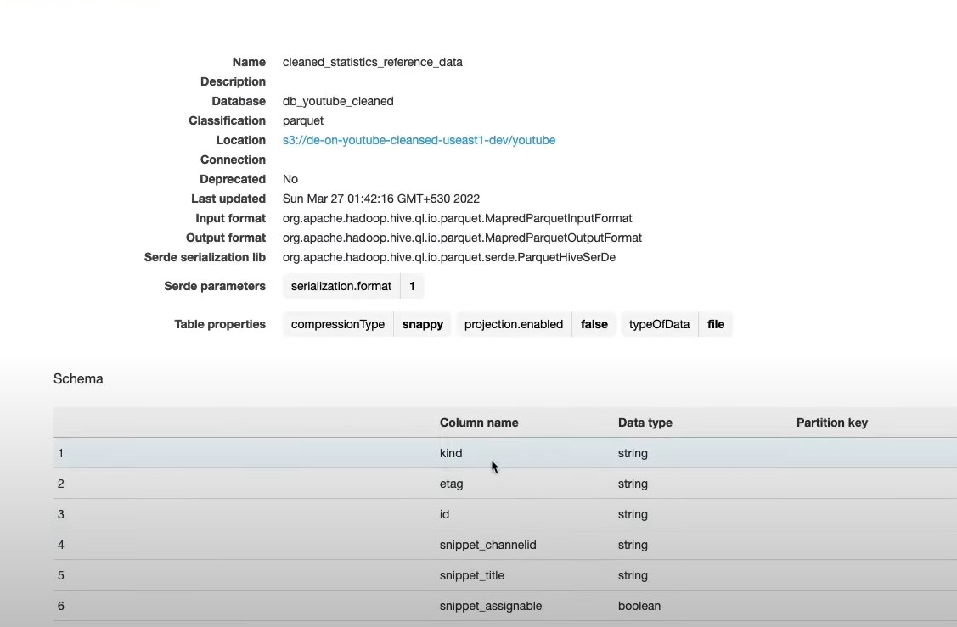
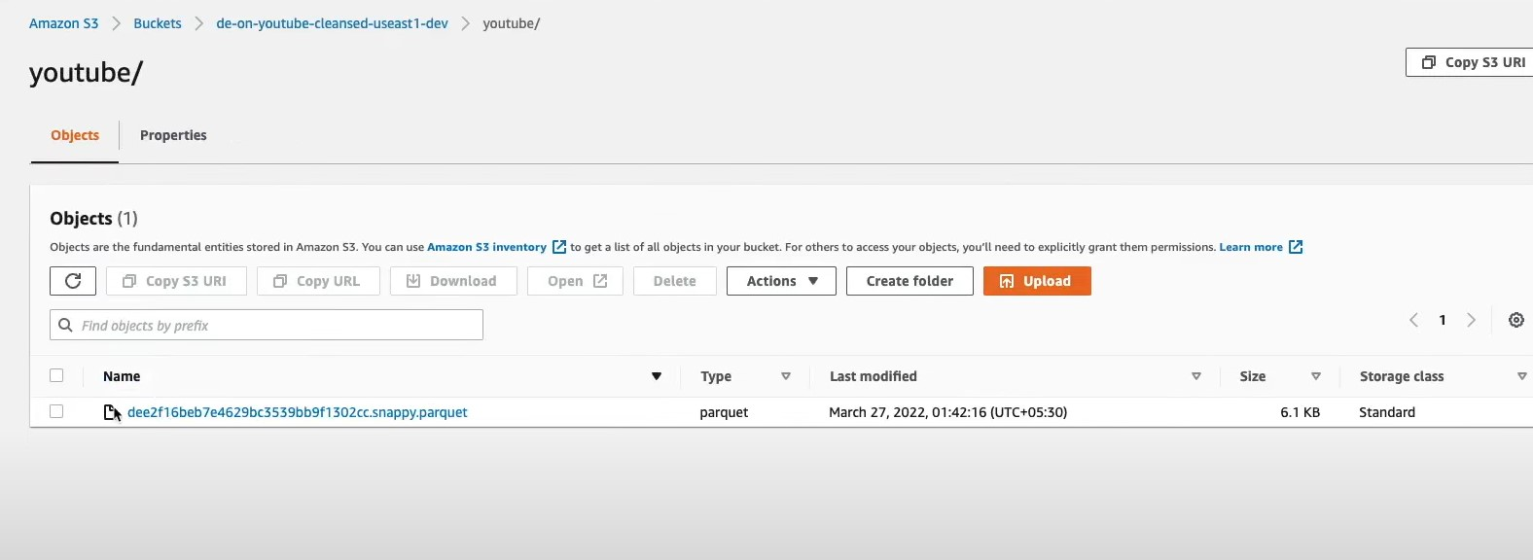
4.5 After the Function successfully runs it will create a parquet file in the cleaned S3 Bucket an also will load a new Table in the Aws Glue.
In Total for The Table we Have 6 Columns
Processed Data stored in the new S3 Bucket

Slide 35
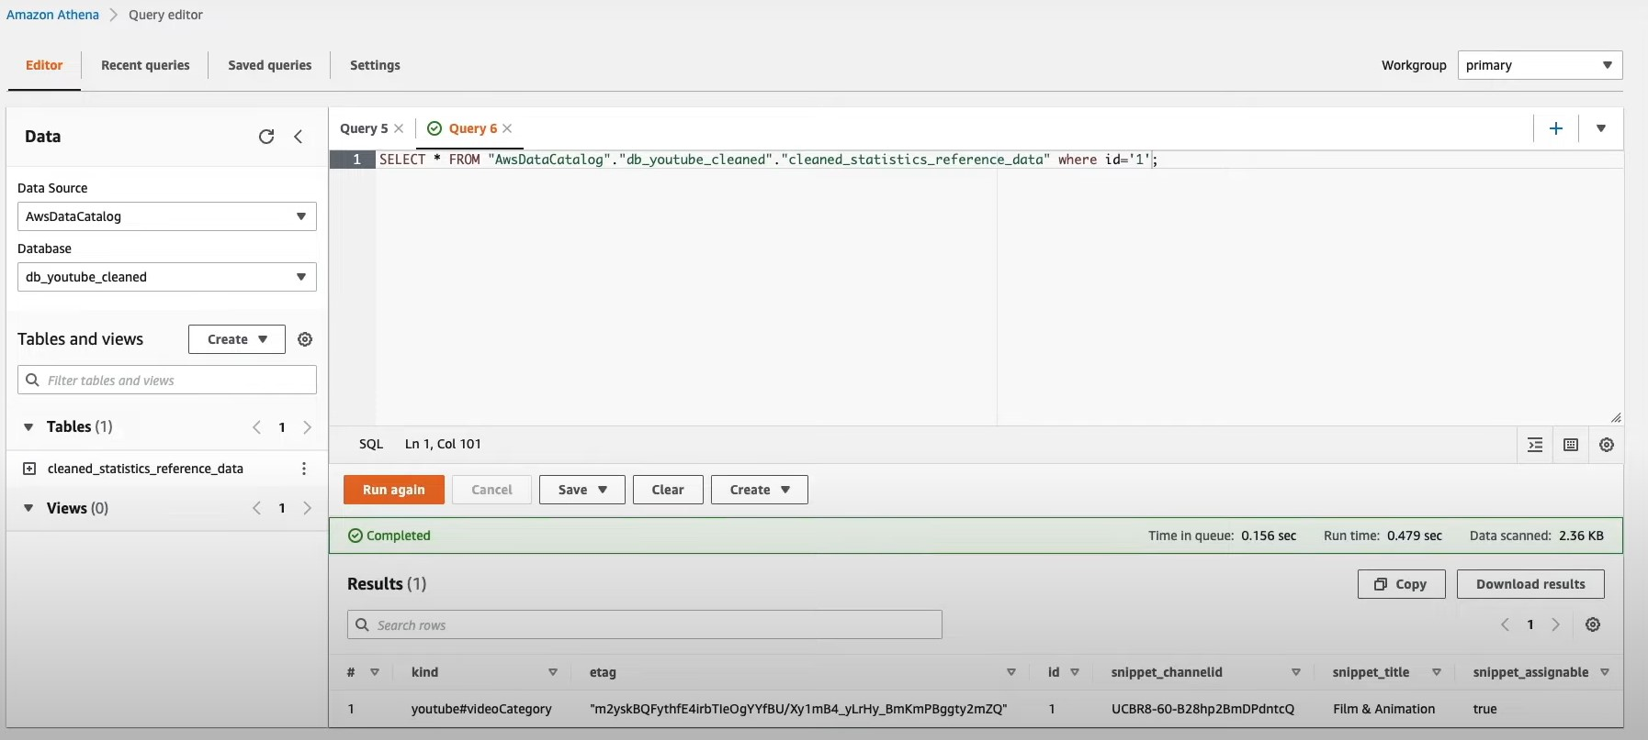
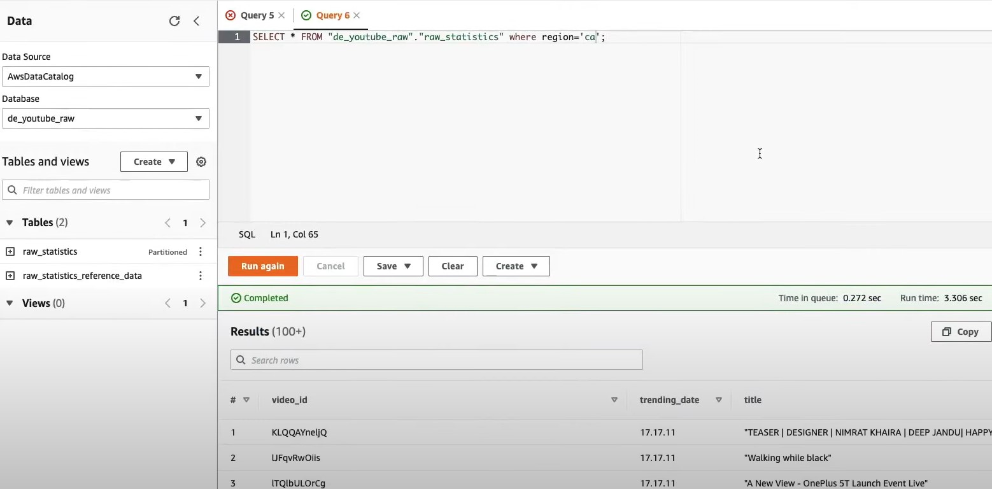
4.6 Now we can Query on the Structured Data and we get the results as defined below:
Similarly, Need to do the same process apart from the conversion of json to parquet format for the csv Files.
So, Now in total in Athena, we have 1 Database – Db_Youtube_Raw in which we have 3 Tables (1. Raw_statistics_referenced_data – Raw Json Files, 2. Clean_statistics_referenced_data – Processed Json Files – Parquet Format, 3. raw_statistics – for the csv files stored Country/Region wise
When Querying the .csv Files since are records portioned by the Country Code’s, we can apply the where clause to see any country’s data.
Then, we are Joining the raw_statistics & raw_statistics_referenced_data Tables on the category_id Column which is the Pk for the Json Format data and id which is the Fk of .csv Files
Query performed on Parquet Files
Query Performed on .csv Files

Slide 36
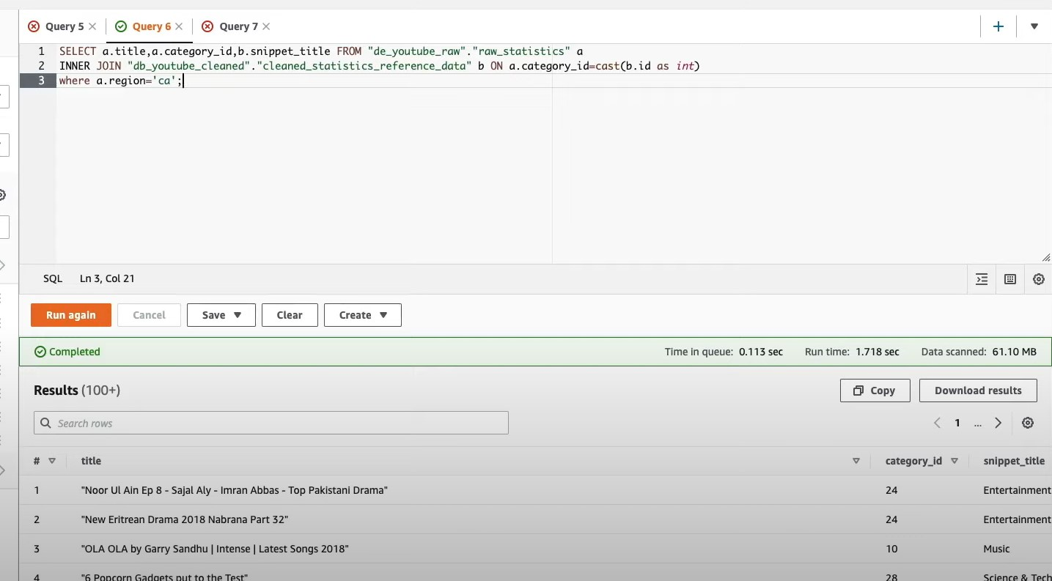
4.7 While Querying we got to Know, that the id column is of VarChar(size) / String Type & category_id is of Int Type, so we casted it to Int, but it will not make permanent changes (Use Alter Command) in the Table, but for selecting the data will work.
Note: Here we have joined the 2 tables but not stored the output results in the Combined/ Target S3 Bucket – That will be done in the next Steps

Slide 37
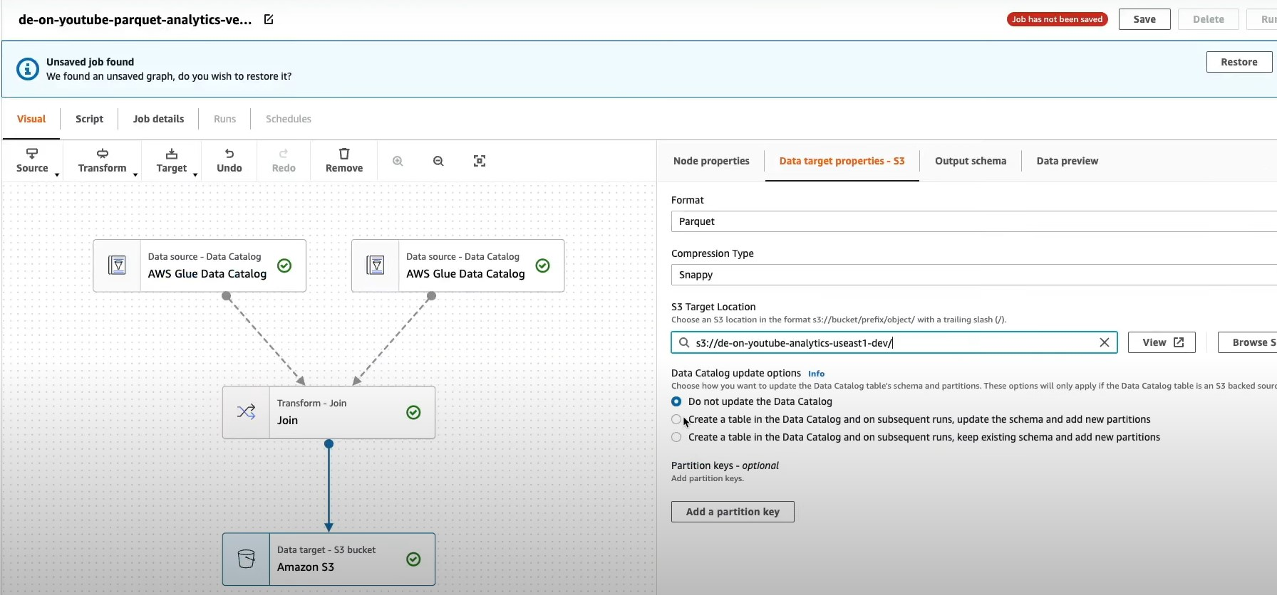
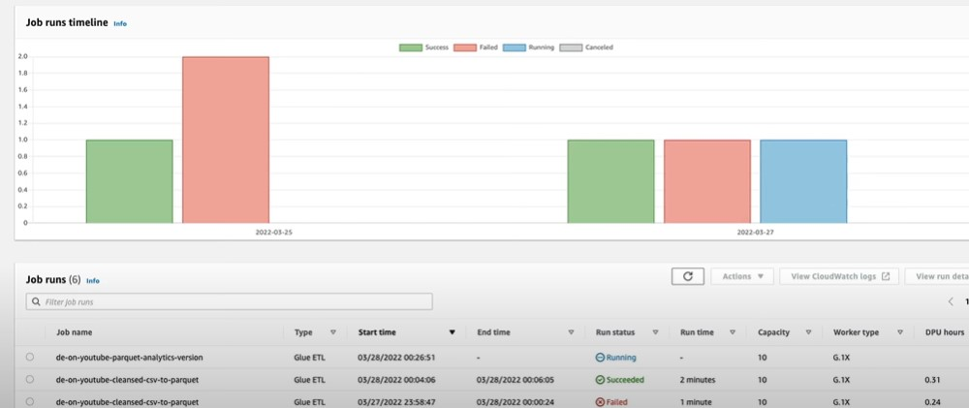
Step 5. Build the ETL Data Pipeline, Together for both type’s of Files(Parquet & Csv) via Aws Glue Data Studio , Also Create a Target S3 Bucket to store the Query Results. Also we can Monitor the Jobs running in different Clusters (Different Status for Jobs: Failed, Succeded, Running, Abort)

Slide 38
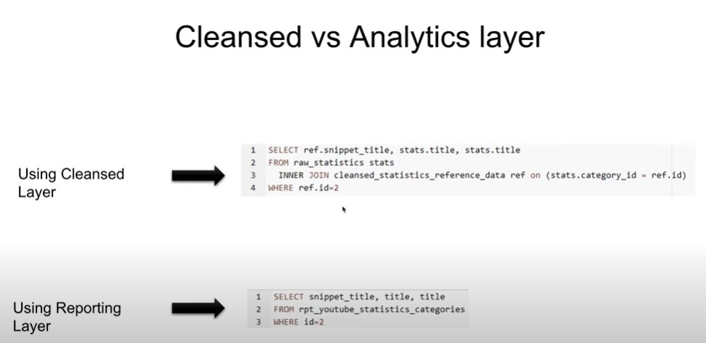
Note: So, For Faster Query Performance we’ll Query the Data using the Reporting Layer, so Here have Created a View/ Index and can Give to Data Scientist/ Business Analyst as they only require the end Results

Slide 39
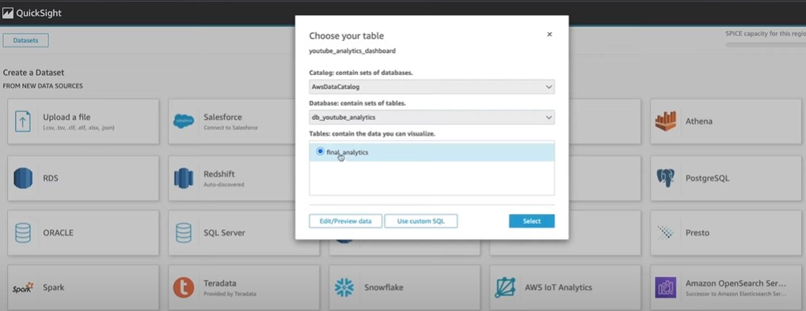
Step 6. Use the Aws Quicksight to Visualize the Data.
6.1 After Logging in to your Quicksight Account, go to top left pane → Manage Quicksight – Security & Permission’s – Select all the Landing/ Raw , Cleaned & Analytical/Target Bucket .
6.2 Go to Datasets & Connect with Athena and there give the Database Name, Table Name which were previously given in Aws Glue Data Catalog and it will automatically Load the Data & Now create Interactive Dashboards & Stories according to the Problem Statements given by the Client.

Slide 40
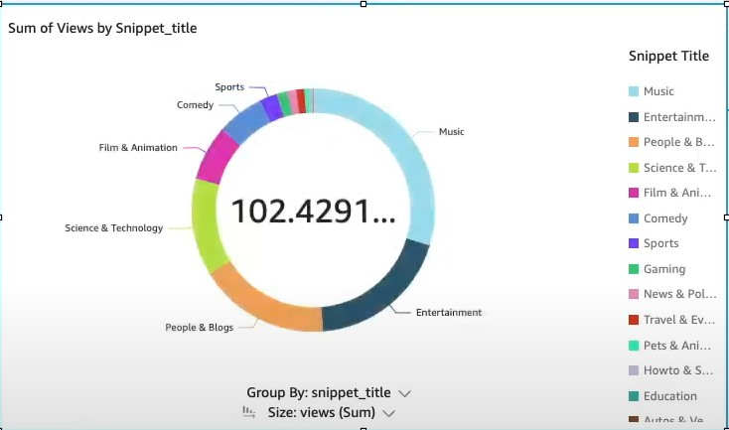



Slide 41


Slide 42
Thanks For Going Through the Case Study
Made By: Kunal Anand
Role: Data Engineer at Cognizant
Mail Id: kunalanand2907@gmail.com
Phone Number: 7042939501

